Slide 1

Department of
Electronics & Communication Engineering
A Mini Project on
POSTURE MONITORING SYSTEM USING ESP32
AND IMU SENSOR
UNDER THE ESTEEMED GUIDANCE OF : SUBMITTED BY :
Mr.C.Ujwal K. Shravyanjali - 24RP5A0413
Department of ECE K. Kiranmai - 24RP5A0414
P. Varshini - 24RP5A0422
N. Akshitha - 24RP5A0421

Slide 2
CONTENTS
Introduction
Objectives
Block diagram
Components
Advantages
Applications
Future Scope
Conclusion

Slide 3
INTRODUTION
Importance of Posture
Proper posture is essential for maintaining physical health, ensuring correct body alignment, and reducing stress on muscles and ligaments.
Problem Statement
Increased use of digital devices and sedentary lifestyles lead to poor posture, causing issues like back pain, reduced productivity, and low concentration.
Need for Solution
Traditional methods like physiotherapy are costly and lack continuous monitoring, creating a need for an automated real-time posture tracking system.
Proposed System Overview
The system uses IMU sensors and a microcontroller to monitor posture continuously and provide instant feedback to correct improper posture.

Slide 4
OBJECTIVES
The objective of this project is to develop a real-time posture monitoring system using an ESP32 microcontroller and an IMU sensor to continuously track body movements and orientation. The system aims to accurately detect incorrect posture and provide immediate feedback to the user through alerts, helping them correct their posture. Additionally, the project focuses on creating a low-cost, portable, and efficient solution that promotes healthy posture habits and prevents long-term health issues.
The system continuously observes the user’s body posture, detects deviations from correct alignment, and provides real-time alerts. It aims to improve user awareness, encourage healthy sitting habits, and reduce posture-related health problems.

Slide 5
EXISTING METHOD.
“Before our project, there were some existing methods to monitor posture.
One common method is manual observation, where people try to correct their posture by themselves using mirrors or by awareness. However, this is not effective because people cannot monitor continuously.
Another method is using basic wearable devices like posture belts. These devices help maintain posture, but they do not provide intelligent feedback or alerts.
Some advanced systems use camera-based monitoring, where posture is analyzed using image processing. But these systems are costly, require a fixed setup, and raise privacy concerns.
There are also simple sensor-based systems that use fixed threshold values, but they may not be very accurate and need proper calibration.
So, these existing methods have limitations such as a lack of real-time alerts, high cost, lower accuracy, and inconvenience.”

Slide 6
PROPOSED METHOD:
The system uses an IMU sensor to collect real-time posture data (X, Y, Z axis).
Data is transmitted to ESP32 using I2C communication.
ESP32 processes the data using a trained machine learning model.
The model classifies posture as correct or incorrect.
If incorrect posture is detected, a buzzer alert is activated.
The system works in real-time and independently after programming.

Slide 7
BLOCK DIAGRAM
POWER SUPPLY
IMU SENSOR
ESP32 MICROCONTROLLER
Posture detection algorithm
Wi-fi / Bluetooth module
Alert system (buzzer/LED)
Mobile app / Cloud data

Slide 8
HARDWARE & SOFTWARE COMPONENTS
ESP32 MICROCONTROLLER
IMU SENSOR
BUZZER
CONNECTING WIRES
DATASET
GOOGLE COLLAB
ARDUINO IDE

Slide 9
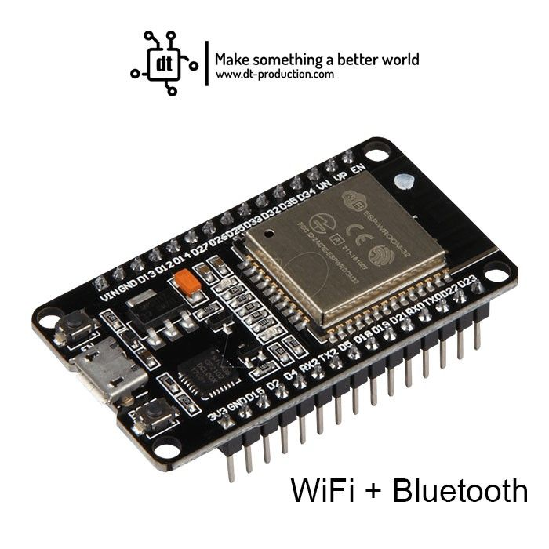
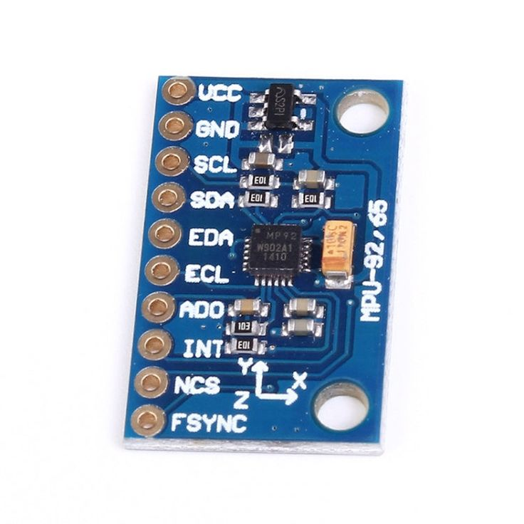
ESP32 MICROCONTROLLER:
ESP32 has built-in wireless communication features, allowing the system to send data and alerts to mobile devices in real time.
It offers processing with low power consumption, making it suitable for continuous monitoring applications like posture detection.
IMU SENSOR:
The IMU sensor measures acceleration and angular velocity using an accelerometer and gyroscope, helping to detect body movement and posture accurately.
It continuously provides data about body position and tilt, enabling the system to monitor posture and identify incorrect alignment instantly.

Slide 10
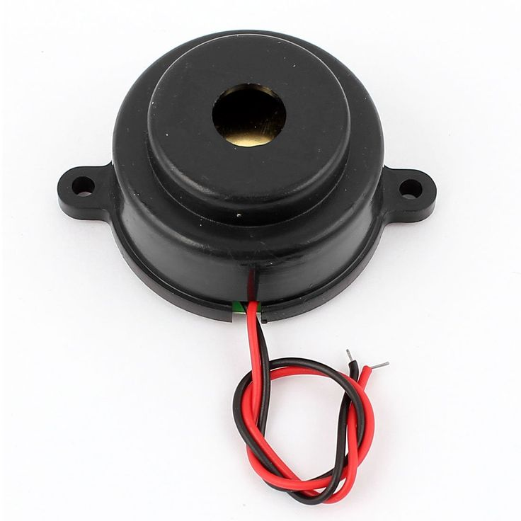
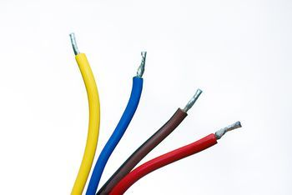
BUZZER:
1. Provides an audible alert when incorrect posture is detected.
2. Helps the user take immediate corrective action.
CONNECTING WIRES :
1. Used to establish connections between all components in the system.
2. Ensure proper signal and power transmission for smooth operation.

Slide 11
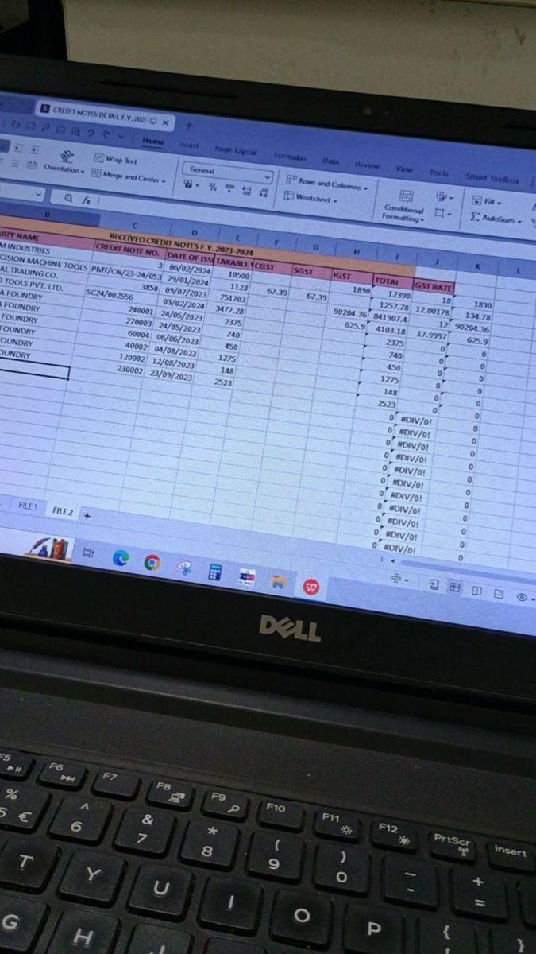
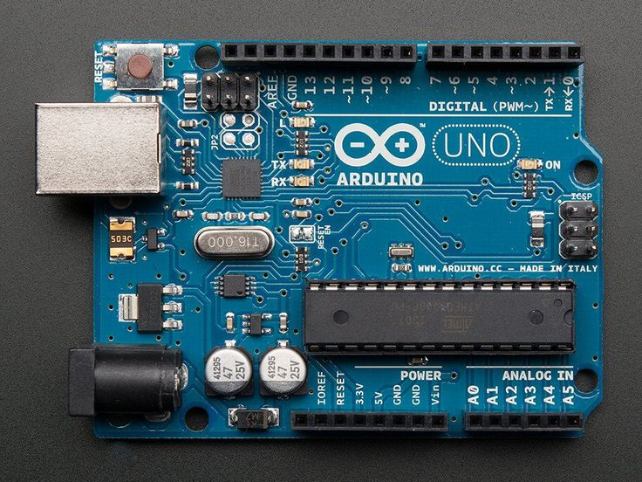
DATA SET & GOOGLE COLLAB:
The dataset consists of posture-related sensor data collected from the IMU sensor, which is used to train and test the system for accurate posture detection. Google Colab is used as a cloud-based platform to process, analyze, and build models using this data, allowing easy implementation without the need for high-end local computing resources.
ARDUINO IDE:
Arduino IDE provides a simple platform to write, compile, and upload code to the ESP32, making development easy even for beginners.
It offers a wide range of built-in libraries (for sensors like IMU) and tools for serial monitoring, which help in testing and debugging the system efficiently.

Slide 12
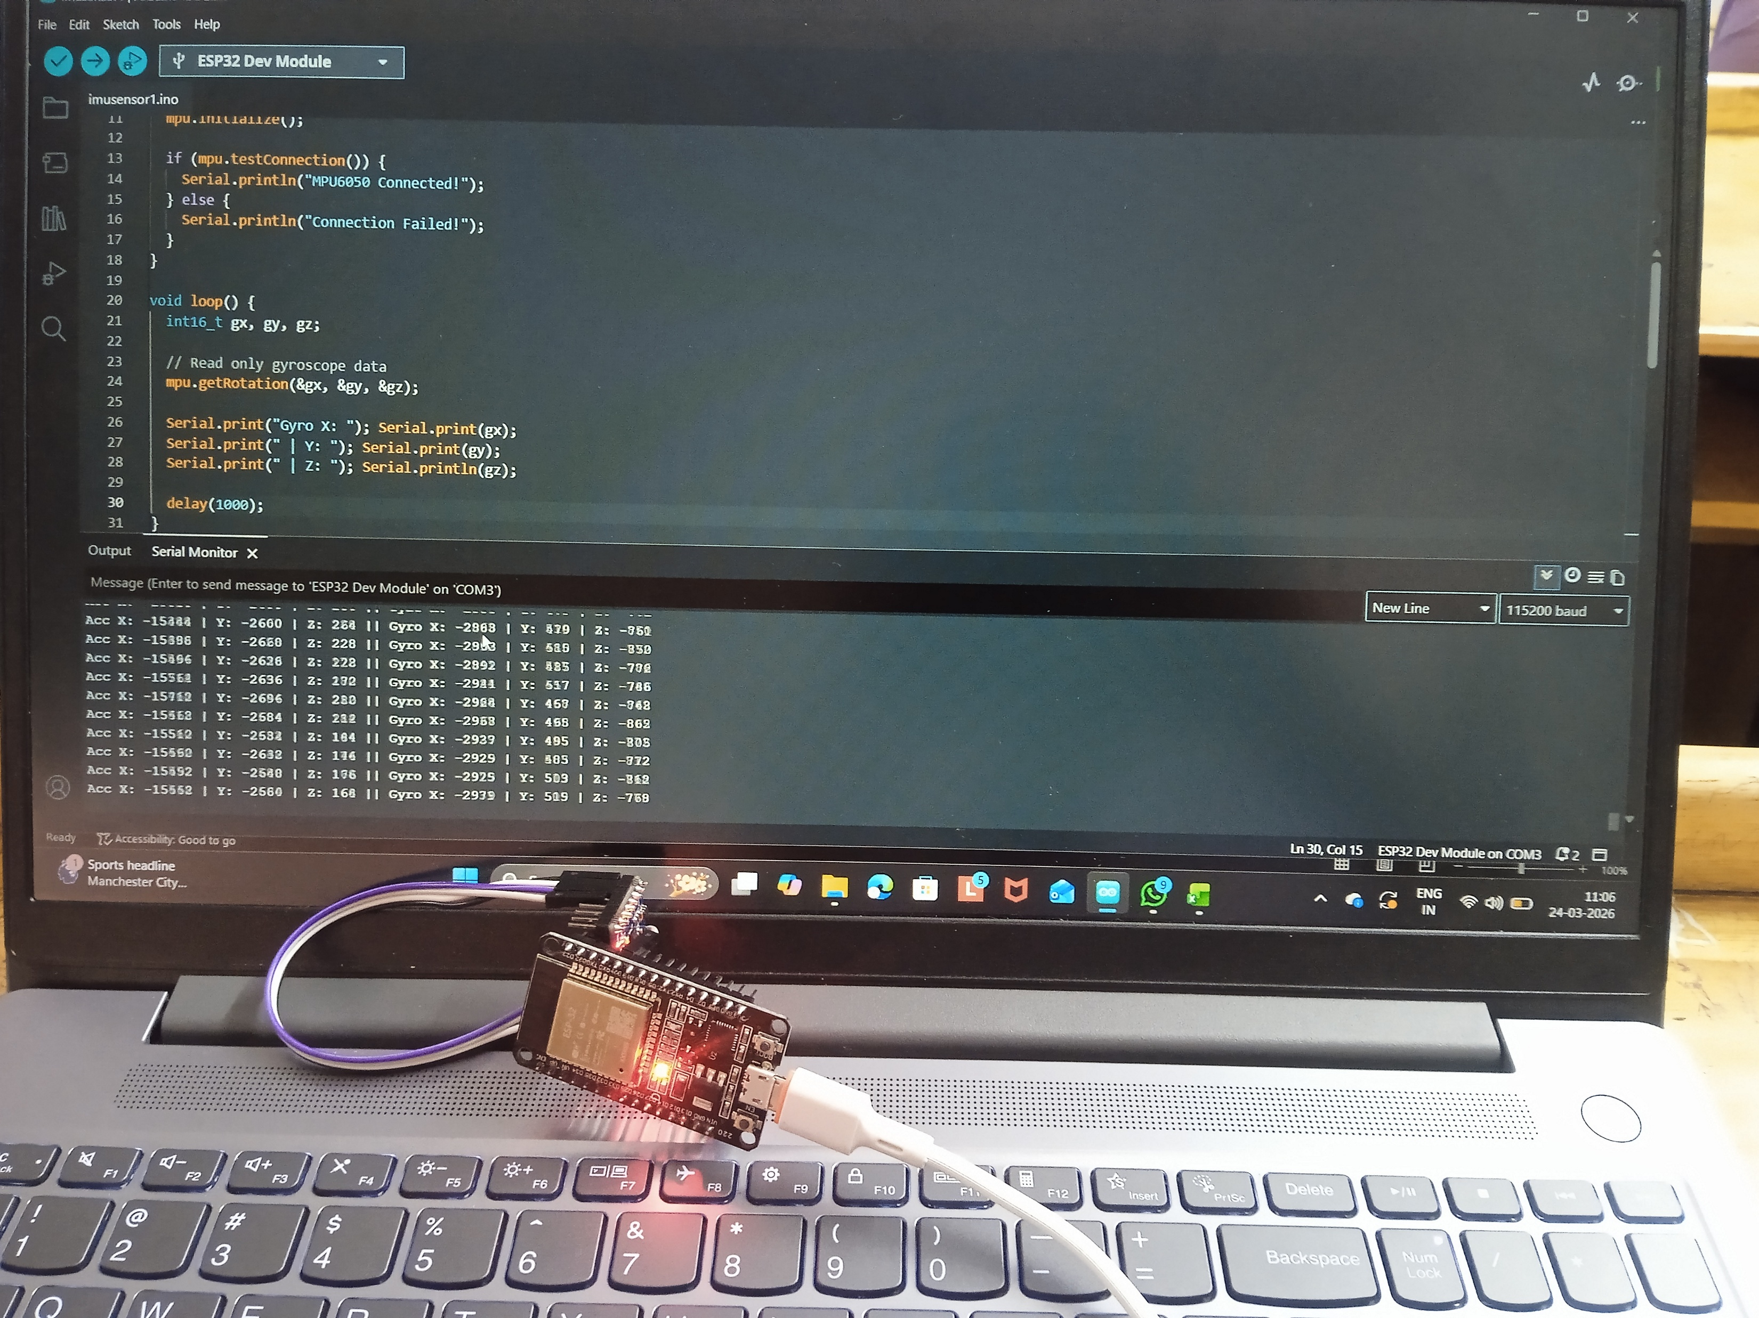
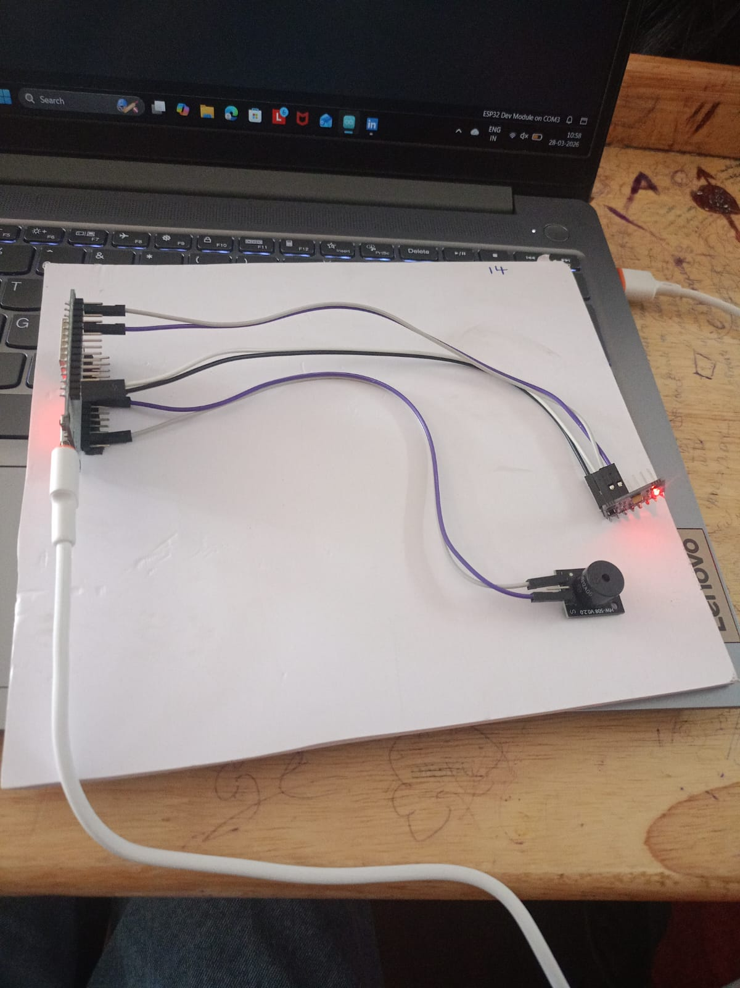
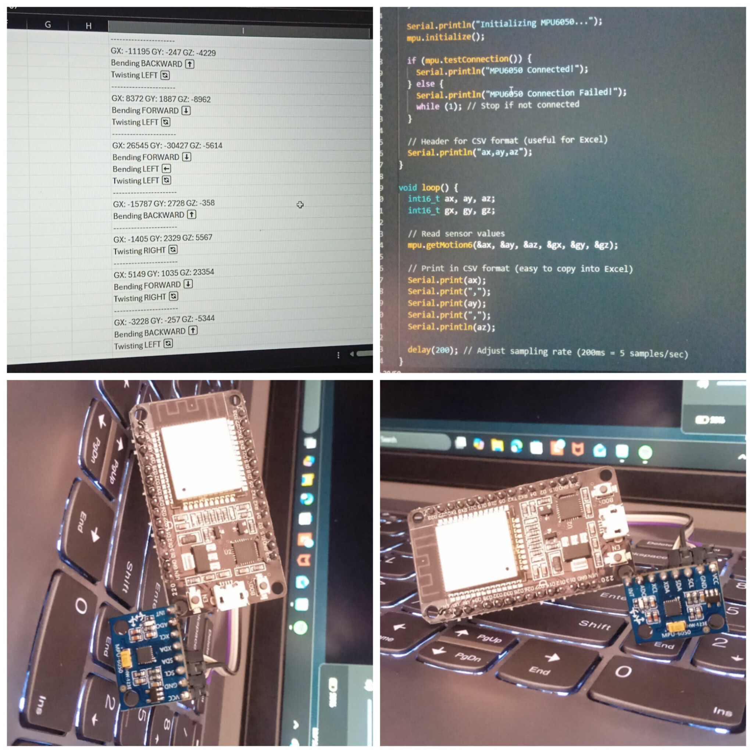

Slide 13
ADVANTAGES
Improves posture habits through continuous monitoring
Helps prevent back pain and spinal problems
Provides real-time alerts for immediate correction
Low-cost and affordable solution
Portable and easy to use in daily life
Supports wireless connectivity (Wi-Fi/Bluetooth)

Slide 14
APPLICATIONS
Used by students to maintain proper posture
Helps office workers during long sitting hours
Useful in healthcare for posture monitoring
Applied in fitness and yoga training
Helps elderly people maintain body alignment
Used in wearable health devices
Supports physiotherapy and rehabilitation programs

Slide 15
FUTURE SCOPE
The system can be enhanced by integrating mobile applications for real-time monitoring and data analysis, and by using AI/ML algorithms for more accurate posture prediction. It can also be developed into a smart wearable device with improved sensors and battery efficiency, making it more user-friendly and widely applicable in healthcare and fitness industries.

Slide 16
CONCLUSION
1. The project successfully monitors body posture in real time using ESP32 and IMU sensor.
2. It helps in detecting incorrect posture and provides immediate feedback for correction
3. The system is low-cost, portable, and suitable for daily use.
4. It promotes healthy posture habits and helps prevent long-term health issues.

Slide 17
THANK YOU!

